Slide 1
Adaptive Load Balance Scheme for the Distributed Control Plane in SDN
Yuwen ZHOU, Bangbang REN, Junjie XIE, Zhi ZHOU, Xu CHEN, Zhiguang CHEN, Deke GUO
Frontiers of Computer Science, DOI: 10.1007/s11704-025-41400-6

Slide 2
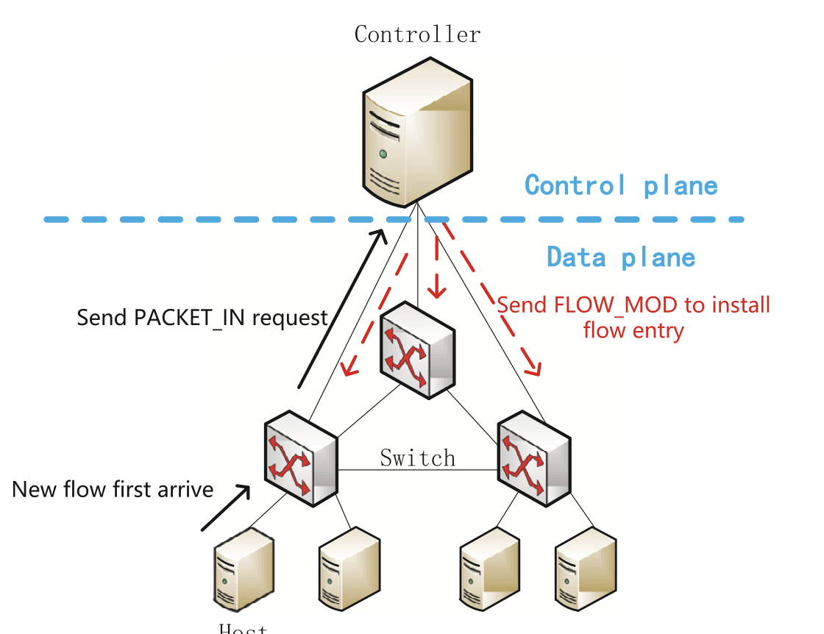
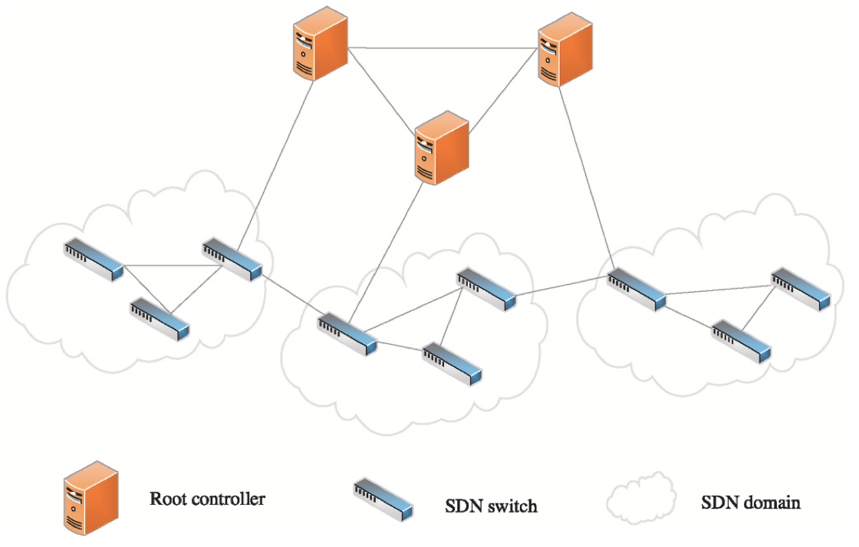
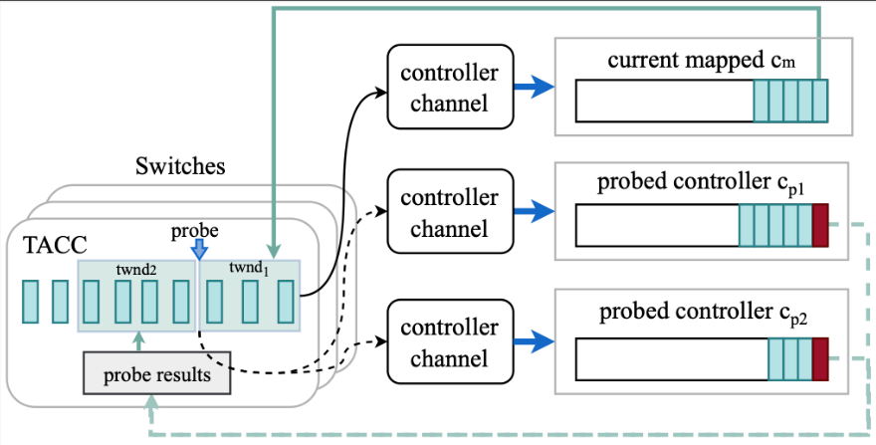
Problems and Ideas
Changing the controller-switch mapping relationship
Balance the load on the controllers
Forward the flow
Who? When? Which?
Estimated efficient time for a relationship changing
Traditional-fixed period
Changing the relationship
Adaptive estimated efficient time
Our TACC
Changing the relationship
Let switches to decide the mapping controller with lighter load using the adaptive probe window.

Slide 3
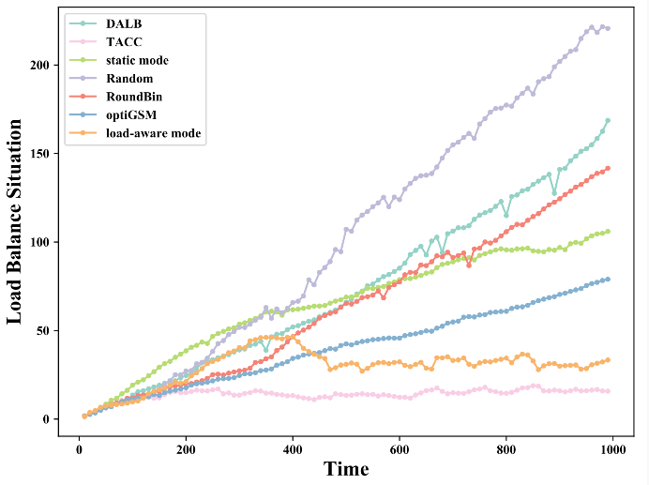
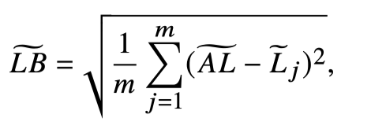
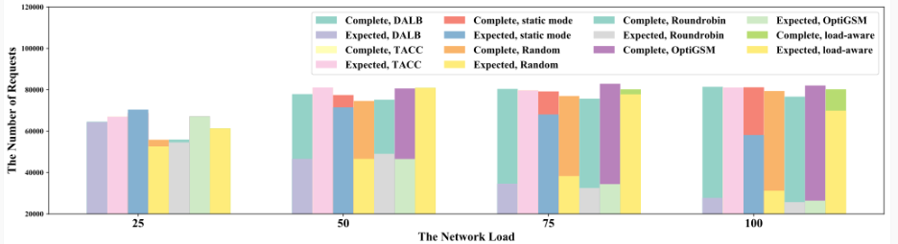
Main Results
Six compared schemes
Different network load
Homogeneous and heterogeneous controllers
The deviation of the response delay
TACC is light and efficient
TACC achieves over 99% of completed requests within 200ms(the expected response delay for the switch) even under heavy load

