Slide 1
Adaptive genetic algorithms guided by decomposition for PCSPs: application to frequency assignment problems
Lamia SADEG-BELKACEM, Zineb HABBAS,
Wassila AGGOUNE-MTALAA
Frontiers of Computer Science, DOI:10.1007/s11704-016-4552-4

Slide 2
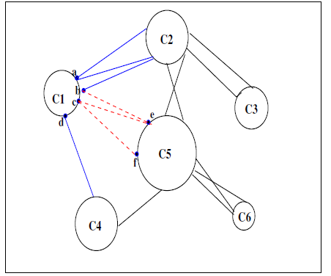
Problems & Ideas
Problem : Resolve real large instances of PCSP problems close to the optimum in the shortest time possible.
Ideas:
  Using structural knowledge to guide (AGA_PCSP)
  Proposition of Adaptive Genetic Algorithms Guided by Decomposition called AGAGD_x_y
    x : corresponds to the decomposition algorithm.
    y : corresponds to the crossover operator.
    structural knowledge considered in AGAGD, which are clusters, cuts and separators

Slide 3
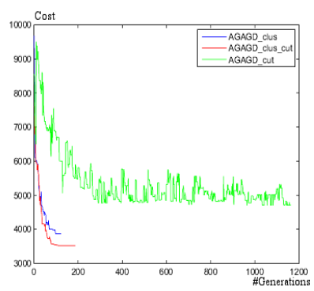
Main Contributions
Comparing some versions of AGAGD
The hybrid version of AGAGD is more efficient and stable than those using only one type of crossover. This is because the use of crossovers based on the cluster and others based on the cut at the same time leads to a good tradeoff between diversification and intensification.

