Slide 1
Effects of smartphone icon background shapes and figure/background area ratios on visual search performance and user preferences
Shijian LUO, Yuxiao ZHOU
Frontiers of Computer Science, 2015, 9(5):751–764

Slide 2
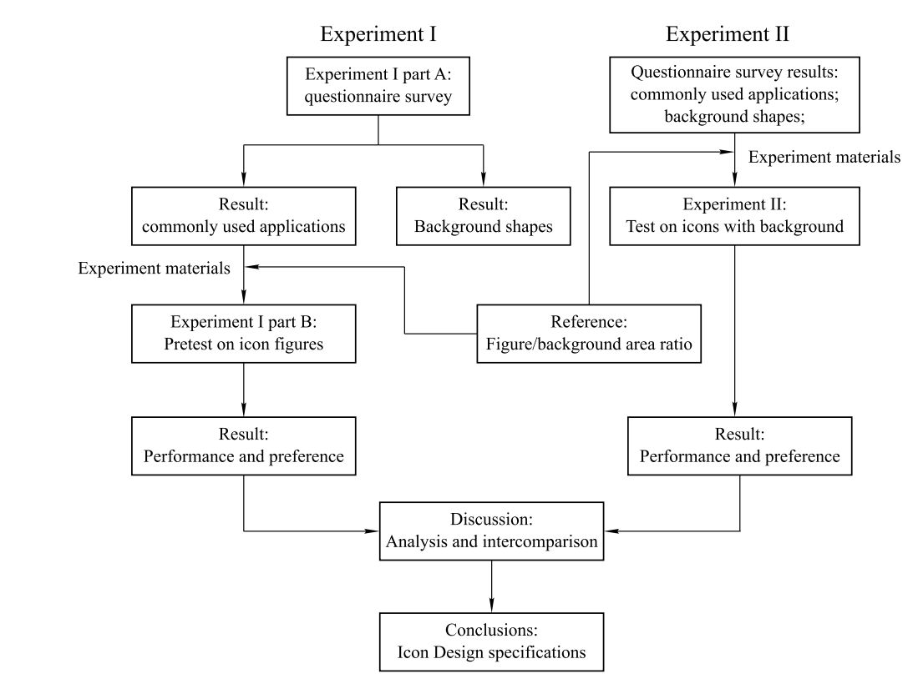
Problems & Ideas
Problems of icon design on Smartphone
  Lack of guidelines for icon design
  Lack of evidence support how different background shapes and figure/background area ratio would affect the performance and preference
Ideas: Smartphone icon design guideline
  Evaluate the icon design factors on smartphone
  Different background shapes and figure/background area ratios are employed
  3 main screen sizes are tested

Slide 3
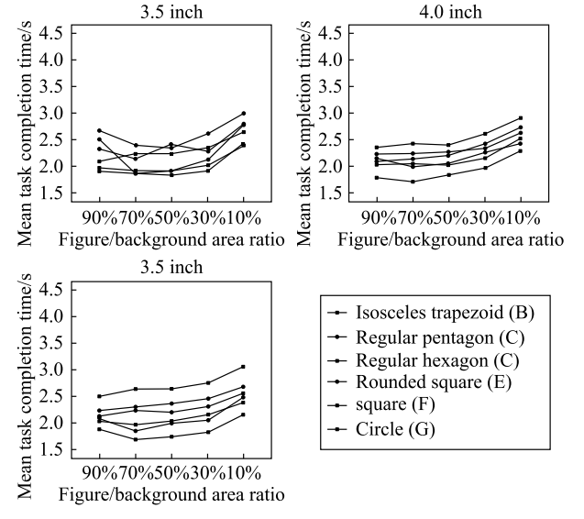
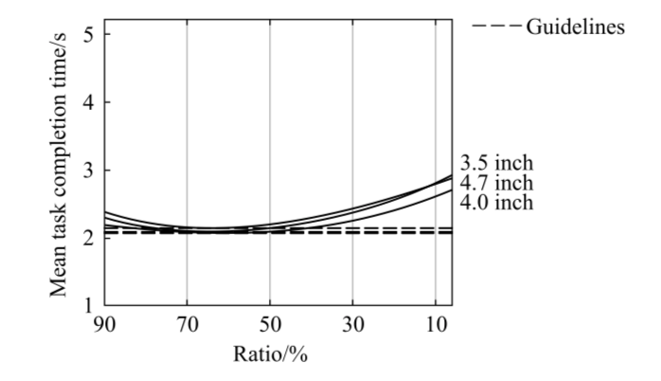
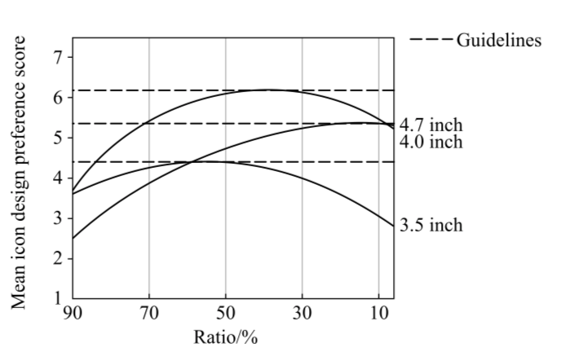
Main Contributions
On 3.5-inch and 4.0-inch screes, unified icon background with square or rounded square are recommended
A 60% figure/background area ratio is the most appropriate for smartphone icon in 3.5-inch screen, while 50% is suitable for 4.0-inch, no background icon is suggested for 4.7-inch

